Slide 1
Sprint 1 Team 4 Text Mining
Ahmed Ashraf, Amanda Long, Zawaad Shah

Slide 2
Topic:
Text Mining using SpaCy
MSSQL for database management
Dataset: Employee reviews of FAANG companies

Slide 3
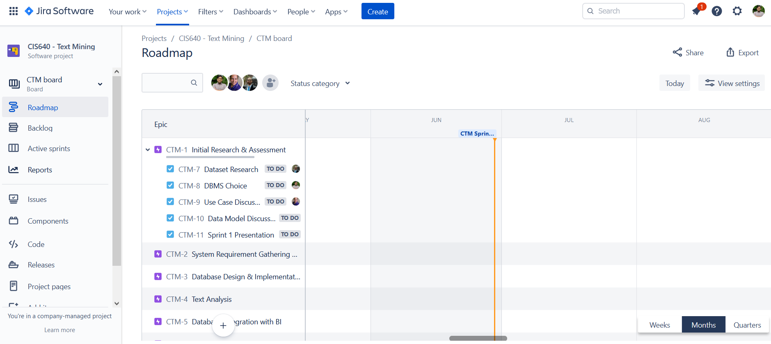
Project management setup
Using Jira

Slide 4
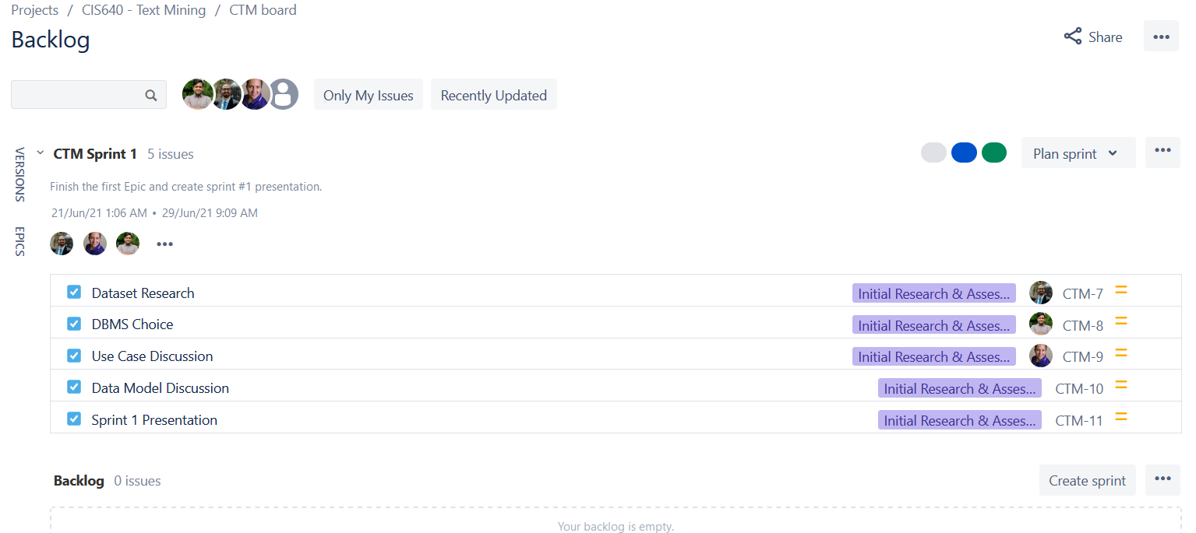

Slide 5
Current tasks
Research example projects that use SpaCy
Choose appropriate dataset
Select and setup DBMS environment: MSSQL or MongoDB
Setup SpaCy

Slide 6
Tasks for next sprint
Fill database with data

